Slide 1
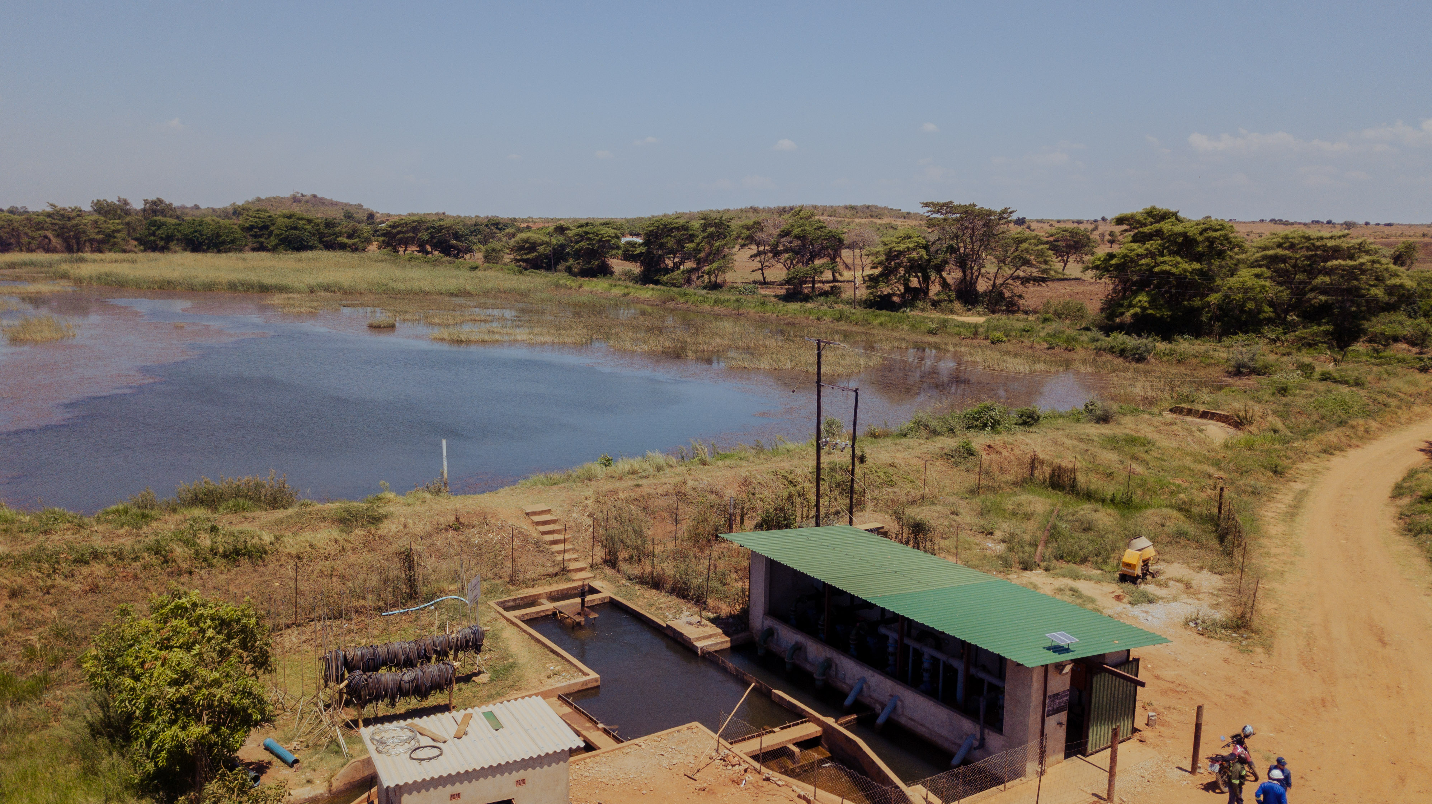
Sub-Surface Drip Irrigation Development Evaluation Project - Feasibility Study
Kaleya Smallholders Company Limited

Slide 2
Content
Introduction
Comparative analysis of existing technologies
Proposed SDI expansion
Borehole option
Solar option
Geo-information and sensors
SDI operating strategies
Return on investment analysis
Comparison of results based on Operating Scenarios
Corporate Governance
Concluding remarks

Slide 3
1. Introduction
Purpose of study is determine viability of converting furrow irrigation into sub-surface drip irrigation (SDI)
Pre-feasibility study conducted in 2021 to assess existing data, information and infrastructure
Current study is continuation, focusing on technical and financial viability of various solutions
Study area is a 311 ha area selected by KASCOL
Study conducted by team of consultants working under Aquaquest Ltd

Slide 4
2. Comparative analysis
A comparison of different irrigation systems was conducted being:
  1. Furrow Irrigation
  2. Center Pivot Irrigation
  3. Sub-surface Drip Irrigation
  All three technologies are currently present at KASCOL, though a 150 ha SDI was installed only recently, and has not yet had a harvest

Slide 5
2. Comparative analysis (2)

Slide 6
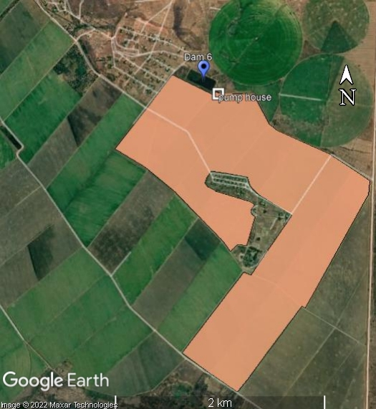
3. Proposed SDI Expansion
Location

Slide 7
3. Proposed SDI Expansion
Design Criteria
Crop type | Sugar Cane
Area size (ha) | 311
Crop spacing | Continuous
Rows distance (m) | 1.9
Row direction | Mainly from East to West
Min. Required capacity system (mm/day) | 6.8
Emitter flow rate (indication- open for suggestions irrigation supplier) (l/hr) | 0.8-1.2 lph (designer prerogative within this range)
Emitter spacing (range) | 0.4 m - 0.6 m (designer prerogative within this range)
Lateral spacing (m) | 1.9
Max irrigation time per day (hours) | 20
Soil data | Loamy clay 0 - 45 cm; gradually increasing clay content with depth towards heavy clay soil 45 - 100 cm
Effective rooting depth (m) | 0.45
Maximum rooting depth (m) | 0.95
suggested Irrigation interval | 3-5 days
Energy type | Electricity
Water Source | Reservoir (volume 38,800m3) water transferred from Kafue River
Min irrigation zone size | Designer prerogative. Flexibility in irrigation is important: when fields reach field capacity, the irrigation manager should be able to stop irrigating, while on fields that did not yet reach field capacity irrigation should be continued (differences might be caused by crop stage, health, soil type, climatological conditions, exposure, drainage, etc.).
Fertigation | yes, include fertigation option
Filtration | Primary automatic Screen filtration; Block level: semi-automatic filtration

Slide 8
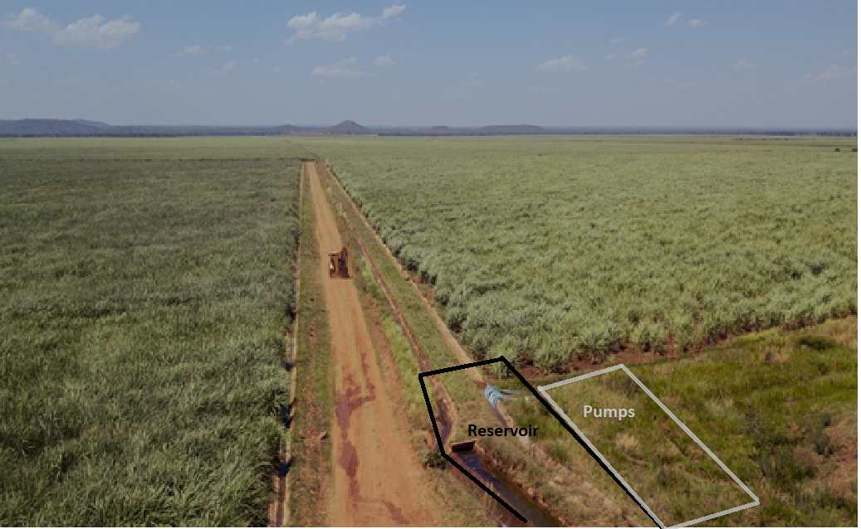
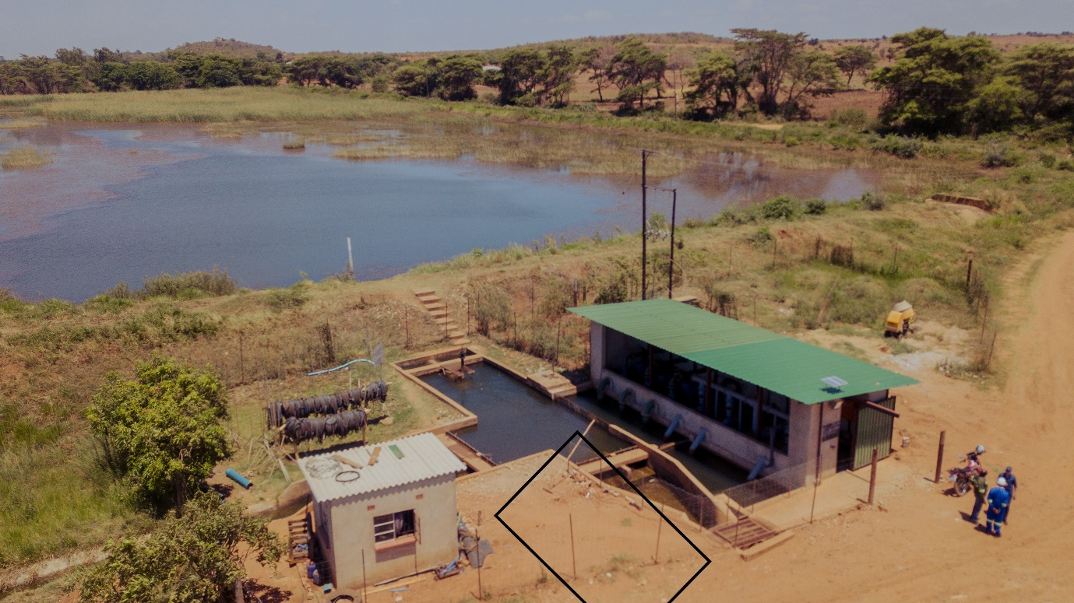
3. Proposed SDI Expansion
Pump Station: 6 pumps of roughly 240 m³/hr
Two proposed locations near Dam 6
Water source from either existing supply and/or boreholes
New 315 KVA transformer required

Slide 9
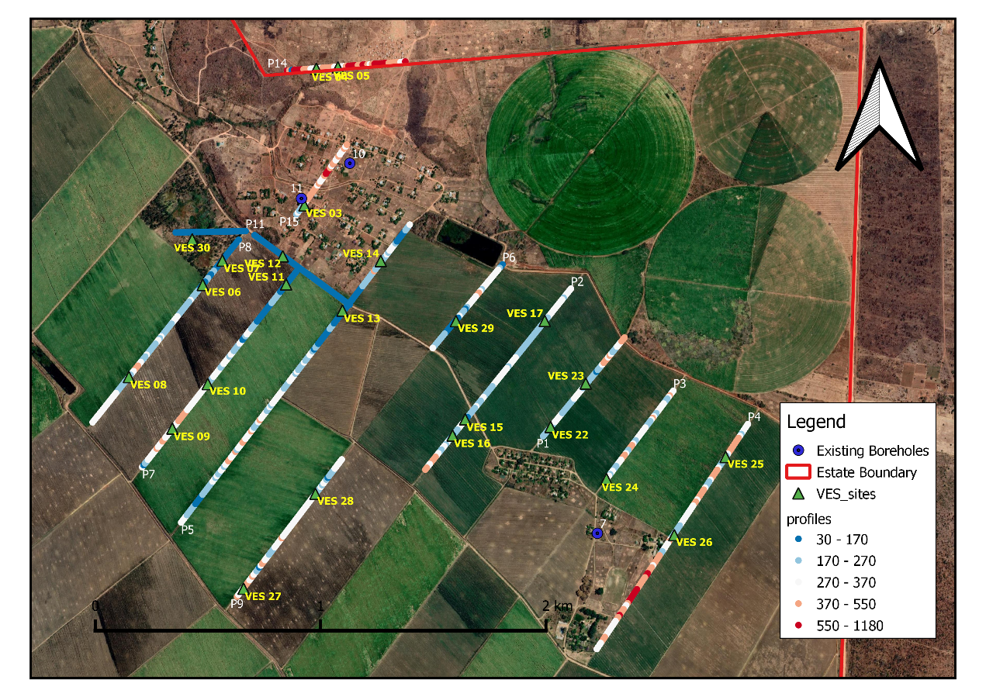
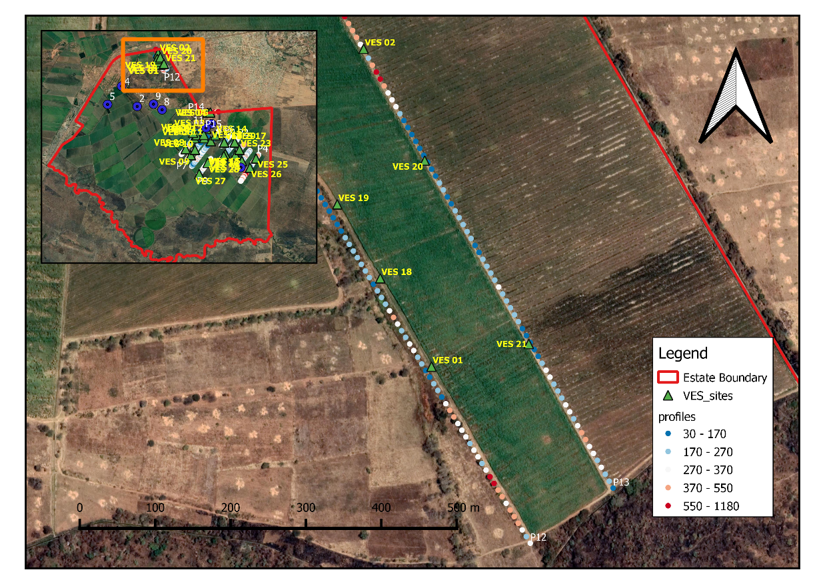
4. Borehole option
Geophysical survey conducted
11.2 km of resistivity profiling and 30 Vertical Electrical Soundings (VES)
5 sites selected for follow-up drilling

Slide 10
4. Borehole option
Exploratory drilling of 5 pilot holes
Drilling conducted by SL Drilling
PH03 and PH04 selected for further development

Slide 11
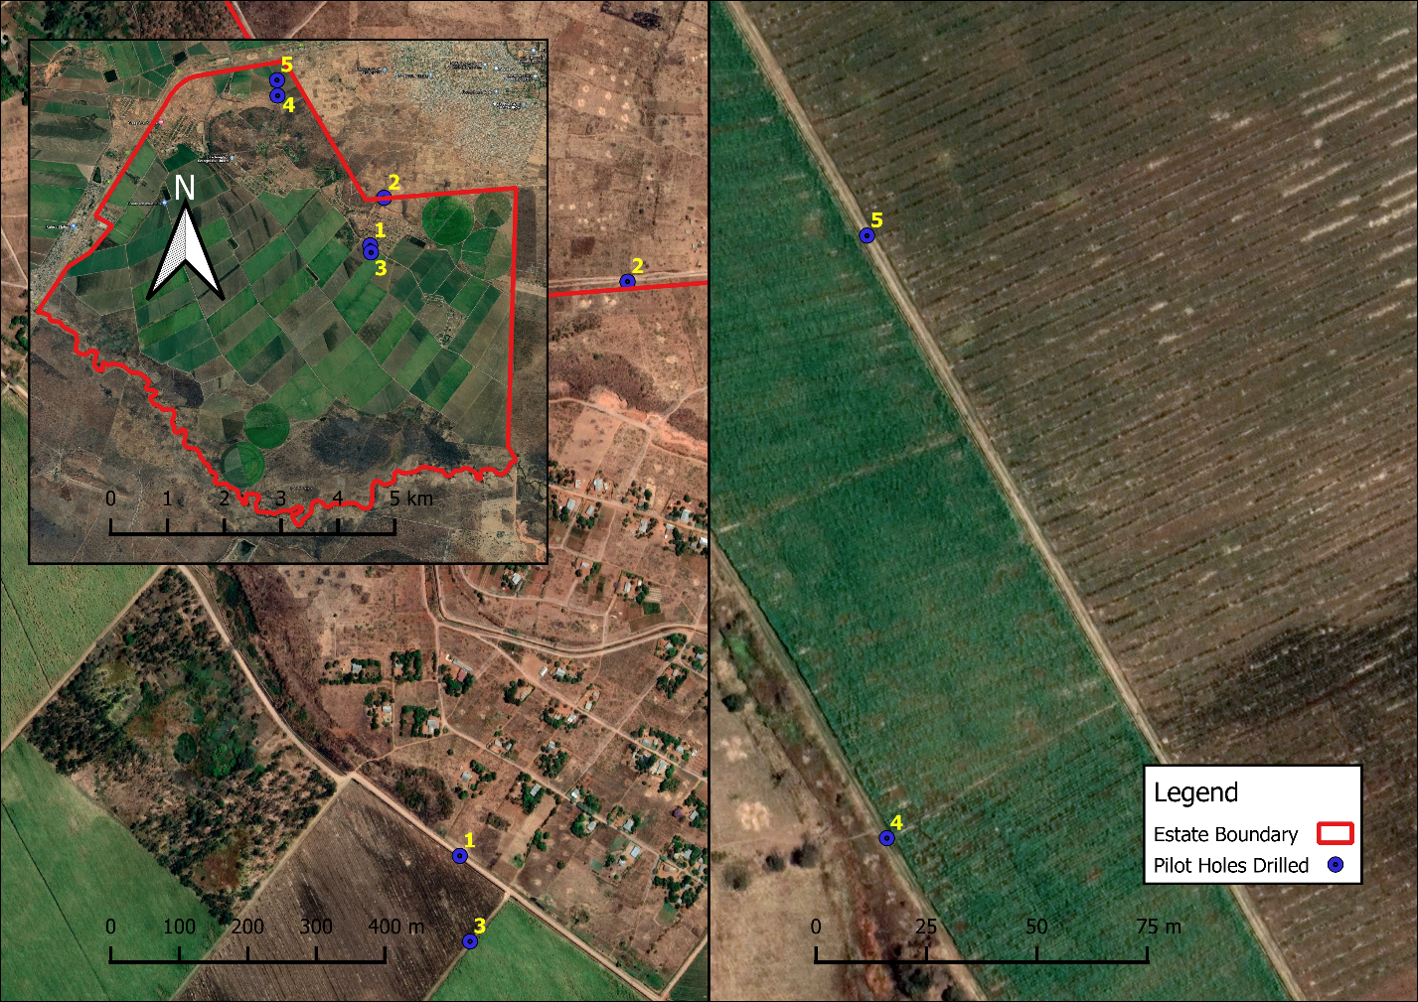
4. Borehole option

Slide 12
4. Borehole option
Development of PH03 and PH04 into BH01 and BH02 successful
Installed with 8.5-inch steel casing
Yields attained of 14 and 9 l/s, measured after 1 hour of development (flushing)
BH01 overlain by alluvial formation, possibly affected by irrigation water
BH02 in carbonate formation
To be confirmed with pumping tests once project is being implemented

Slide 13
4. Borehole option
General recommendations:
25 boreholes of 10 l/s to meet irrigation requirements
Boreholes to pump into Dam 6
Test pump boreholes before starting development

Slide 14
4. Borehole option
Investment cost estimate boreholes
Item | Unit Rate | Quantity | Total
Additional geophysics | ZMW 30,000.00 | 1 | ZMW 30,000.00
Mobilization driller | ZMW 30,000.00 | 1 | ZMW 30,000.00
Pilot Hole Drilling | ZMW 20,000.00 | 50 | ZMW 1,000,000.00
Borehole Installation | ZMW 175,000.00 | 25 | ZMW 4,375,000.00
Borehole Test Pumping | ZMW 50,000.00 | 25 | ZMW 1,250,000.00
Supervision (10% of total drilling costs) |  |  | ZMW 665,500.00
Total |  |  | ZMW 7,350,500.00
Item | Unit Rate | Quantity | Total
Pump and auxiliaries incl control box (15 kW) | ZMW 209,965.00 | 25 | ZMW 5,249,125.00
Powerlines (per m) | ZMW 262.50 | 12500 | ZMW 3,281,250.00
Water pipelines from BH to dam, incl trenching (per m) | ZMW 100.00 | 12500 | ZMW 1,250,000.00
Total |  |  | ZMW 9,780,375.00
Depreciation | Amount
20-years (excl pumps) | ZMW 594,087.50
10-years (pumps) | ZMW 524,912.50
Total | ZMW 1,119,000.00

Slide 15
5. Borehole option
Operational costs
Total Costs
Zamsugar: 0.286 ZMW/m³
 | Water required (m3/year) | Per BH (m3/year) | Hours of pumping at 10 l/s | Costs per BH/year | Costs total 25 Boreholes per year
OS-A | 4,742,750.00 | 189,710 | 5,270 | ZMW 83,472.40 | ZMW 2,086,810.00
OS-B | 3,557,062.50 | 142,283 | 3,952 | ZMW 62,604.30 | ZMW 1,565,107.50
OS-C | 1,527,258.19 | 61,090 | 1,697 | ZMW 26,879.74 | ZMW 671,993.60
 | Depreciation | Pumping Costs | Contingency / Maintenance (10%) | Total | Total Costs per m3 of water
OS-A | ZMW 1,119,000.00 | ZMW 2,086,810.00 | ZMW 320,581.00 | ZMW 3,526,391.00 | ZMW 0.74
OS-B | ZMW 1,119,000.00 | ZMW 1,565,107.50 | ZMW 268,410.75 | ZMW 2,952,518.25 | ZMW 0.83
OS-C | ZMW 1,119,000.00 | ZMW 671,993.60 | ZMW 179,099.36 | ZMW 1,970,092.96 | ZMW 1.29

Slide 16
5. Solar Option
Only viable option is hybrid option of Solar and ZESCO
1 MW solar park to supply the complete development, including other farming operations
= ZMW 22,618,027 (depr 20 years)
No. | Component | Cost (US$/W) | 1MW IPP
1 | PV Module | $ 0.78 | $ 780,000
2 | Inverter | $ 0.18 | $ 180,000
3 | Cables | $ 0.04 | $ 40,000
4 | Mountings | $ 0.06 | $ 60,000
5 | Engineering & Project Management | $ 0.03 | $ 30,000
6 | Labour | $ 0.06 | $ 60,000
7 | Miscellaneous/P&Gs | $ 0.11 | $ 110,000
 | TOTAL | $ 1.26 | $ 1.260,000

Slide 17
6. Geo-information and sensors
Drones to identify crop-stress (NDVI)
Soil moisture sensors – both stationary and mobile
Use of satellite based information systems to obtain information on e.g. weather, and apply this in crop models
Automated (telemetric) weather stations
Engage dedicated data collection, digitization and analysis person

Slide 18
7. SDI Operating Strategies
Different irrigation scenarios, Operating Strategies, are assessed:
  OS-A: 100% of yield requirement
  OS-B: 75% of yield requirement
  OS-C: Same application as current furrow irrigation
Purpose of project is to look at water saving, but SDI can use more water more efficiently, hence different Strategies

Slide 19
7. SDI Operating Strategies
Water requirements and yields
OS-A
Annual Irrigation req. | 1,525 | mm
 | 3,110,000 | m²
 | 4,742,750,000 | liters
 | 4,742,750 | m³
Water costs 311 ha | 1,789,228 | ZMW/year
water costs /ha | 5,753 | ZMW/year
Yield per ha | 149
ERC (%) | 14.9
ERC ton/ha | 22.2
Yield cane for 311 ha SDI | 46,391
ERC (tons for 311 ha) | 6,912
OS-B
Irrigation req. | 1,144 | mm
 | 3,110,000 | m²
 | 3,557,062,500 | liters
 | 3,557,063 | m³
Water costs 311 ha | 1,341,921 | ZMW/year
water costs /ha | 4,315 | ZMW/year
Yield per ha (tons) | 130.52
ERC (%) | 15%
ERC ton/ha | 19.45
Yield cane for 311 ha SDI | 40,592
ERC (tons for 311 ha) | 6,048
OS-C
Irrigation req. | 491 | mm
 | 3,110,000 | m²
 | 1,527,258,190 | liters
 | 1,527,258 | m³
Water costs 311 ha | 576,166 | ZMW/year
water costs /ha | 1,853 | ZMW/year
yield ton/ha | 114.19
ERC % | 13.31
ERC ton/ha | 15.2
Yield cane for 311 ha SDI | 35,512
ERC (tons for 311 ha) | 4,728

Slide 20
7. SDI Operating Strategies
Power requirements
 | yearly irrigation water | required hours of pumping | number of full days (24hrs) pumping with 6 pumps | average (2023-2027) | costs/ha (ZMW)
OS-A | 4,742,750.00 | 23,713.75 | 164.68 | 1,169,154.17 | 3,759.34
OS-B | 3,557,062.50 | 17,785.31 | 123.51 | 876,865.63 | 2,819.50
OS-C | 1,527,258.19 | 7,636.29 | 53.03 | 376,490.49 | 1,210.58

Slide 21
8. Return on Investment
Analysis
Forecast for 5 year period 2023-2027
Using history data from KASCOL and other sources in combination with anticipated on trends
Analysis done for the three different OS, with and without borehole and solar options

Slide 22
8. Return on Investment
Analysis
Expense type | Expense category | Description
Depreciation initial investment | Depreciation drip lines | Yearly amount accounted for to replace the drip lines every 8 years (before new planting)
 | Depreciation SDI main components | Yearly amount accounted for as depreciation of main components (e.g. main pipe lines, filtration station, pumps); linear depreciation model used, lifetime system 20 years.
 | Sensors & information technology | Yearly depreciation of expenses related to information, sensors and innovation management. This includes the fee for internal innovation operator or the engagement of an external consultant.
Operating costs | Water use | The costs contributed by the water consumption (assumes all water supplied by Zambia Sugar)
 | Electricity (ZMW/kWh) | Yearly expenses of electricity (for ZESCO supply) in situations without solar unless otherwise indicated in report.
 | Labour (including maintenance SDI) | Expenses towards labour, including non- irrigation-related work, such as planting and harvesting.
 | Farm inputs (fertilizer) | Expenses towards fertilizer application
 | Farm inputs (chemicals) | Expenses towards chemicals of pest and disease control
 | Weed control | Labour expenses related to weed control
 | Other farm inputs | All other farm inputs such as tools, fuel, minor repairs
 | Haulage | Costs related to the transport of the harvested sugar cane to processing facility (outsourced to Zambia Sugar)
 | Farm Machinery | All costs concerning farm machinery such as tractors, and agri-equipment from KASCOL.
Finance costs | Finance costs | Interest, cost of loan
Others | Overhead (admin, overhead etc) | Contribution towards admin and other overhead costs.

Slide 23
8. Return on Investment
Analysis
ROI for option without solar and boreholes – expenses in ZMW
ROI analysis per Operation Strategy (OS) – Expected Annual Costs |  | OS-A | OS-B | OS-C
Depreciation initial investment | Depreciation drip lines | 503,676 | 503,676 | 503,676
 | Depreciation SDI main components | 1,547,068 | 1,547,068 | 1,547,068
 | Depreciation sensors & information technology | 416,170 | 416,170 | 416,170
Operating costs | Water use | 1,789,228 | 1,341,921 | 576,166
 | Electricity | 1,169,154 | 876,866 | 376,490
 | Labour (including maintenance SDI) | 815,159 | 815,159 | 815,159
 | Farm inputs (fertilizer) | 2,393,303 | 2,127,381 | 1,861,458
 | Farm inputs (chemicals) | 200,632 | 200,632 | 200,632
 | Weed control | 200,551 | 200,551 | 200,551
 | Other farm inputs | 945,397 | 945,397 | 945,397
 | Haulage | 4,205,788 | 3,680,065 | 3,219,593
 | Farm Machinery | 1,143,989 | 1,143,989 | 1,143,989
Finance costs | Finance costs | 1,994,195 | 1,994,195 | 1,994,195
Others | Overhead (admin, overhead etc.) | 2,410,555 | 2,410,555 | 2,410,555
Total |  | 19,734,865 | 18,203,623 | 16,211,099

Slide 24
8. Return on Investment
Analysis
ROI for option without solar and boreholes – expenses in %
Category | Factor | OS-A | OS-B | OS-C
Depreciation initial investment | Depreciation drip lines | 2.6% | 2.8% | 3.1%
 | Depreciation SDI main components | 7.8% | 8.5% | 9.5%
 | Depreciation sensors & information technology | 2.1% | 2.3% | 2.6%
 |  | 12.5% | 13.6% | 15.2%
Operating costs | Water use | 9.1% | 7.4% | 3.6%
 | Electricity | 5.9% | 4.8% | 2.3%
 | Labour (including maintenance SDI) | 4.1% | 4.5% | 5.0%
 | Farm inputs (fertilizer) | 12.1% | 11.7% | 11.5%
 | Farm inputs (chemicals) | 1.0% | 1.1% | 1.2%
 | Weed control | 1.0% | 1.1% | 1.2%
 | Other farm inputs | 4.8% | 5.2% | 5.8%
 | Haulage | 21.3% | 20.2% | 19.9%
 | Farm Machinery | 5.8% | 6.3% | 7.1%
 |  | 65.2% | 62.3% | 57.6%
Finance costs | Finance costs | 10.1% | 11.0% | 12.3%
Others | Overhead (admin, overhead etc) | 12.2% | 13.2% | 14.9%

Slide 25
8. Return on Investment
Analysis
ROI for option without solar and boreholes – turnover
Yield & Turnover per year | OS-A | OS-B | OS-C
Yield per ha (ton cane) | 149 | 131 | 114
total yield (ton cane) (for 311 ha) | 46,391 | 40,592 | 35,513
ERC content (%) | 15 | 15 | 13
ERC (ton/ha) | 22 | 19 | 15
total ERC (ton) (for 311 ha) | 6,912 | 6,048 | 4,728
Price per ton (ZMW) | 4,681 | 4,681 | 4,681
turnover/ha (ZMW) | 104,039 | 91,034 | 71,159
Total turnover 311 ha | 32,356,218 | 28,311,691 | 22,130,579

Slide 26
8. Return on Investment
Analysis
ROI for option without solar and boreholes – ROI
ROI | OS-A | OS-B | OS-C
Total annual revenue | 32,356,218 | 28,311,691 | 22,130,579
Total annual costs | 19,734,865 | 18,203,623 | 16,211,099
Total profit before tax | 12,621,353 | 10,108,068 | 5,919,479
Tax (10% of profit) | 1,262,135 | 1,010,807 | 591,948
Profit after tax | 11,359,218 | 9,097,261 | 5,327,531
ROI (%) | 58% | 50% | 33%

Slide 27
8. Return on Investment
Analysis
Finance costs, for the ROI costing the 5-year period is used
Year | Payback period | 3-year Payback period | 5-year Payback period | 7-year Payback period
2023 | Payback loan year 1 | 10,363,382 | 6,218,029 | 4,441,449
 | Interest year 1 | 3,109,015 | 3,109,015 | 3,109,015
2024 | Pay back loan year 2 | 10,899,993 | 6,539,996 | 4,671,426
 | Interest year 2 | 2,179,999 | 2,615,998 | 2,802,855
2025 | Pay back loan year 3 | 11,436,604 | 6,861,962 | 4,901,402
 | Interest year 3 | 1,143,660 | 2,058,589 | 2,450,701
2026 | Pay back loan year 4 |  | 7,183,929 | 5,131,378
 | Interest year 4 |  | 1,436,786 | 2,052,551
2027 | Pay back loan year 5 |  | 7,505,896 | 5,361,354
 | Interest year 5 |  | 750,590 | 1,608,406
2028 | Pay back loan year 6 |  |  | 5,591,330
 | Interest year 6 |  |  | 1,118,266
2029 | Pay back loan year 7 |  |  | 5,821,306
 | Interest year 7 |  |  | 582,131
TOTAL |  | 39,132,653 | 44,280,790 | 49,643,570

Slide 28
8. Return on Investment
Analysis
Cash flow: negative for OS-C in 5-year pay back period, but positive in 7-year payback period
2023 | OS-A | OS-B | OS-C
Preliminary cashflow prediction with 5-year payback period
Turnover | 32,356,218 | 28,311,691 | 22,130,579
Expenses (excluding depreciation category) | 16,500,373 | 15,153,475 | 13,400,454
Loan + interest | 9,327,044 | 9,327,044 | 9,327,044
Cashflow | 6,528,802 | 3,831,173 | - 596,919

Slide 29
8. Return on Investment
Analysis
Borehole Option
Solar Option
Solar and Borehole Option
ROI | OS-A | OS-B | OS-C
Total yearly revenue | 32,356,218 | 28,311,691 | 22,130,579
Total yearly costs | 22,099,649 | 20,493,771 | 18,373,475
Total profit before tax | 10,256,569 | 7,817,920 | 3,757,104
Tax (10% of profit) | 1,025,657 | 781,792 | 375,710
Profit after tax | 9,230,912 | 7,036,128 | 3,381,394
ROI (%) | 42% | 34% | 18%
ROI | OS-A | OS-B | OS-C
Total yearly revenue | 32,356,218 | 28,311,691 | 22,130,579
Total yearly costs | 21,814,409 | 20,445,299 | 18,730,331
Total profit before tax | 10,541,809 | 7,866,393 | 3,400,248
Tax (10% of profit) | 1,054,181 | 786,639 | 340,025
Profit after tax | 9,487,629 | 7,079,753 | 3,060,223
ROI (%) | 43% | 35% | 16%
ROI | OS-A | OS-B | OS-C
Total yearly revenue | 32,356,218 | 28,311,691 | 22,130,579
Total yearly costs | 23,068,976 | 21,902,783 | 20,535,194
Total profit before tax | 9,287,242 | 6,408,908 | 1,595,385
Tax (10% of profit) | 928,724 | 640,891 | 159,538
Profit after tax | 8,358,518 | 5,768,017 | 1,435,846
ROI (%) | 36% | 26% | 7%

Slide 30
8. Return on Investment
Analysis
Borehole and Solar Options
Without Borehole and Solar Options
ROI | OS-A | OS-B | OS-C
Borehole Option | 42% | 34% | 18%
ROI | OS-A | OS-B | OS-C
Solar Option | 43% | 35% | 16%
ROI | OS-A | OS-B | OS-C
Borehole and solar option | 36% | 26% | 7%
ROI | OS-A | OS-B | OS-C
Without Borehole and Solar | 58% | 50% | 33%

Slide 31
9. Comparison of scenarios
Multi-criteria analysis to aid in the decision making
MCA | Factor | Weights (W) | OS-A | OS-B | OS-C
Economical aspects | Turnover | 1 | 5 | 4 | 2
 | Operating costs | 0.5 | W x 3 = 1.5 | x 4 = 2 | x 5 =2.5
 | SDI investment costs | 0.5 | W x 4 = 2 | x 4 = 2 | x 5 =2.5
 | ROI | 2 | W x 5 = 10 | x 4 = 8 | x 3 = 6
Agricultural factor | Yield | 1 | 5 | 4 | 2
Sustainability factors | Water saving | 2 | W x 1 = 2 | x 3 = 6 | x 5 = 10
 | Water productivity | 2 | W x 2 = 4 | x 3 = 6 | x 5 = 10
 | Chemical fertilizer use | 1 | 4 | 4 | 4
 | Weighted sum | 10 | 33.5 | 36 | 39

Slide 32
9. Comparison of scenarios
OS-A has highest score on economic factors and lowest score on sustainability factors
OS-C has lowest score on economic factors and highest score on sustainability factors
It is a choice for KASCOL to make, all scenarios are economically feasible. Though OS-C has low ROI when considering boreholes and solar

Slide 33
10. Corporate Governance
KASCOL staff was interviewed
The company has 29 permanent staff (of which 11 are in senior positions), 52 permanent staff on a fixed contract (2-3 years), 428 seasonal workers (9 months per year), and 14 temporal staff (on short contract for less than 6 months), plus a harvesting team of 199 seasonal workers
Social model of profitable cane production while ensuring smallholder participation has proven sustainable
Targets not always met possibly due to inefficient water use and supply, SDI system may improve this

Slide 34
10. Corporate Governance
Attract young graduates for modernisation of farming operations and invest in additional monitoring systems (as mentioned before under item 6)
Training staff in usage of SDI
Develop gender strategy to ensure inclusiveness of both men and women

Slide 35
11. Concluding remarks
It is feasible to convert the 311 ha sugarcane from furrow to sub-surface drip irrigation
KASCOL is well positioned to implement the project, with additional training on usage of the SDI and additional monitoring technologies
Both solar and borehole options are feasible for the 311 ha SDI, taking into account a hybrid solar system
OS-A,B,C have an ROI of 58, 50 and 33% respectively.
When both the borehole and solar options are included, the ROI reduces to 36, 26 and 7%
A payback period of 5-years should be considered, however for OS-C a payback period of 7-years may be required

Slide 36
11. Concluding remarks
KASCOL in consultation with DFCD should make a choice as to which scenario is most suitable.
Operating Strategy B (OS-B) seems to have the optimal balance between environmental and economic factors.
The borehole and solar options are possible but come with additional investment costs and risks

Slide 37
Thank You!

